Slide 1
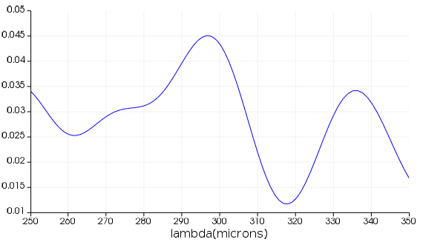
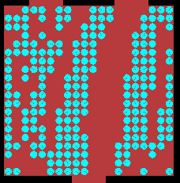
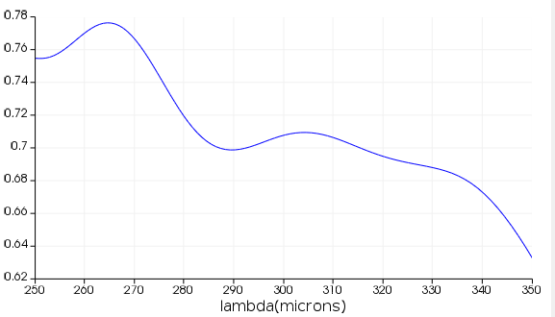
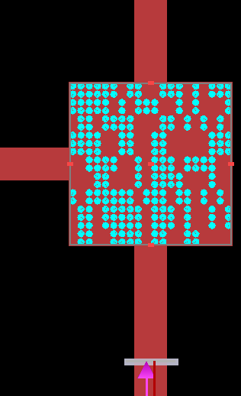
Last Week
This Week
Symmetry 2D Power Splitter
2D Power Splitter
T₁ ~0.03
T₁
T₂
T₂ ~ 0.7

Slide 2
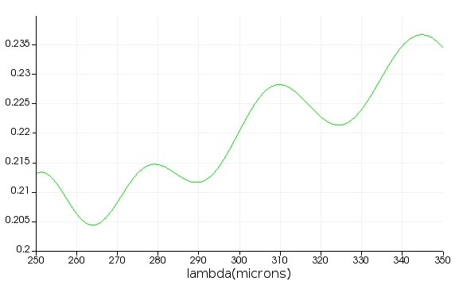
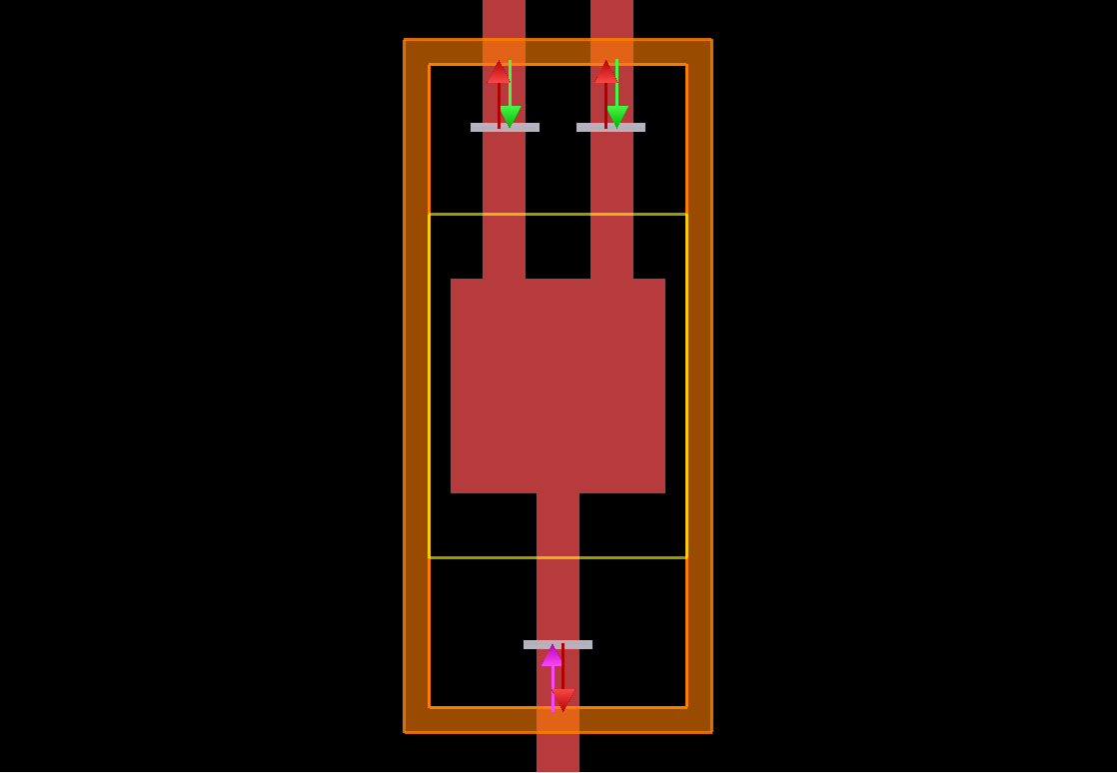
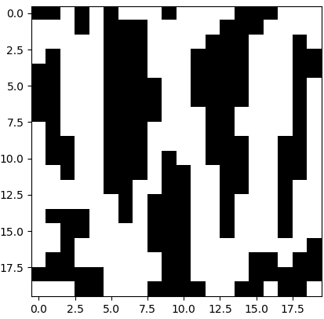
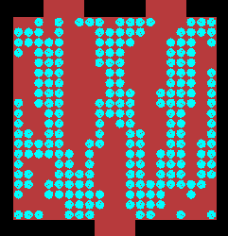
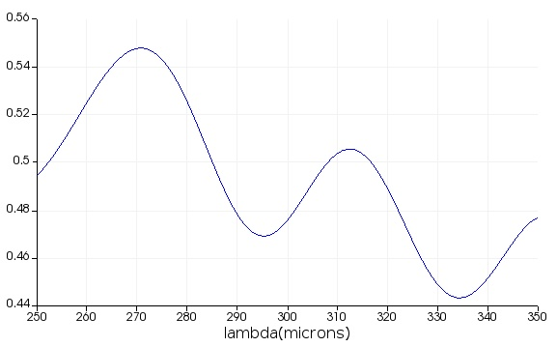
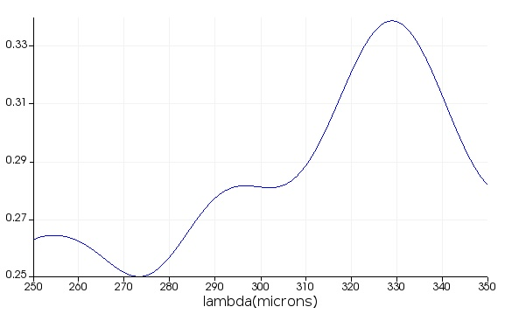
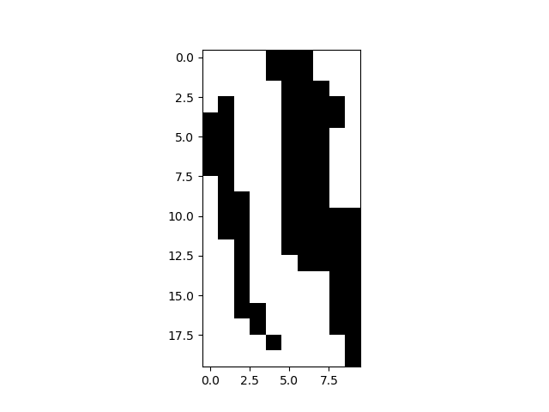
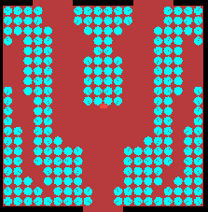
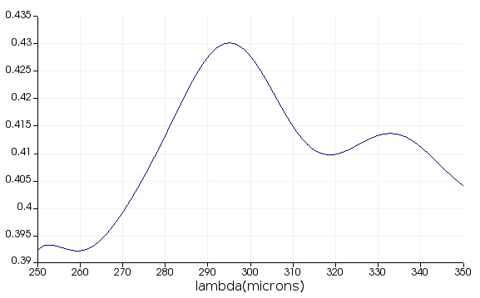
2D Power Splitter – Result
random
T₁
T₂
T₁ ~0.5
T₂ ~ 0.3
symmetry
T₁
T₂
T₁ ~0.41
T₂ ~0.41

Slide 3
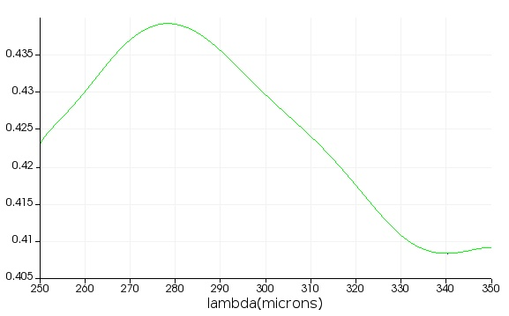
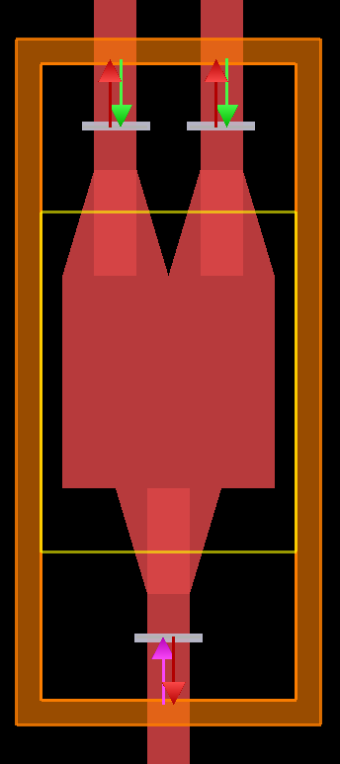
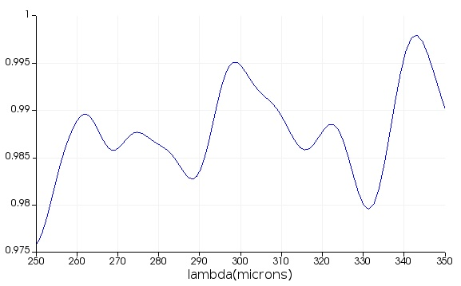
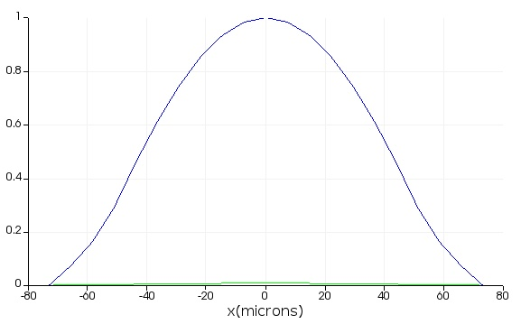
2D Power Splitter – FDTD Setting
Output 1&2
(b)-1
(a)-1
(a)-2
~ 0.4
(b)-2
~ 0.2
Simulation region: 250 ~ 350 um
Waveguide thickness: 100 um
Si Square: 500 um x 500 um
Taper connection: 250 um
Air Holes: 20x20 with a radius of 9 um
T_{input}
TE₁₀ mode

Slide 4
2D Power Splitter – Algorithm
ARLA (Additive Reinforcement Learning Algorithm)
Training
Data
(~ 40,000)
Result
Structure
Algorithm
T₁
T₂
Simulation region: 250 ~ 350 um
FOM = min(T₁) + min(T₂) -> maximize FOM

